Slide 1
AFNWA Interim Drinking Water Regulations:
Treatment requirements, monitoring, and record keeping
Megan Fuller
October 12, 2022

Slide 2
Context for Interim Regulations
Expert Panel on Safe Drinking Water for First Nations (2006)
  Multi-stakeholder panel examined options for a regulatory regime for First Nations’ drinking water. The panel recommended commissioned Indigenous oversight, which would include inspections and holding particular parties, including Federal Agencies, to account. The Panel identified 16 elements of a proposed regulatory system.
Regulatory Framework Report April (2009)
  Produced by Dalhousie CWRS for Atlantic Policy Congress of First Nations Chiefs Secretariat [APC] ; Report determines 14 of the 16 elements proposed by Panel 2006, have direct application to the Atlantic First Nation context.

Slide 3
Context for Interim Regulations
Auditor General Report (2011)
  One of the main recommendations related to water and wastewater programs was a call for a regulatory regime to be implemented in First Nations communities because provincial legislation and regulations are not applicable on First Nation reserves.
Regulatory Benchmarks Report (2012)
  CWRS developed regulations in relation to previous framework and reviewed best practices to developed detailed regulations for First Nations in Atlantic Canada
Safe Drinking Water for First Nations Act (2013)
  The Act called for enforceable regulatory standards, in order to ensure safe drinking water, effective treatment and source water protections. The Act also places Chief and Council completely liable and responsible for the state of drinking water and wastewater discharge within their community. Act clearly defines lines of responsibility between the owner and regulator of water assets. This Act would be an enabling statute for AFNWA’s regulatory capacity

Slide 4
Current State
CWRS hired in 2021 to support AFNWA to update regulations to current state
Current Framework heavily influenced by the Guidelines for Canadian Drinking Water Quality and NS Environment and Climate Change regulations
Framework approved by the AFNWA Board on January 26, 2022 with direction to develop interim regulations in conformance with framework

Slide 5

Notes:
OH&S – include or other provincial statues as needed

Slide 6
Interim Regulations for Drinking Water
Operations
and
day-to-day activities

Slide 7
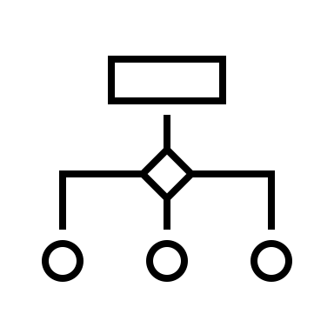
Treatment Requirements: Source Water
Surface water or
GUDI (high-risk)
Low or medium-risk GUDI
Source Water
Non-GUDI
Treatment
Standard
4-log reduction viruses
3-log reduction protozoa
4-log reduction viruses
3-log reduction protozoa
4-log reduction viruses
It depends…
Treatment
Processes
Combination of:
Engineered filtration
+
Disinfection
Disinfection only

Slide 8


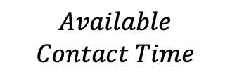
Treatment Requirements
Primary Disinfectant | Requirements
Free Chlorine | The water system shall meet the required CT value, at a minimum, as outlined in Section 9.7 and Appendix 9-D. In the event the minimum required CT is not achieved, contingencies shall be in place to prevent the distribution of inadequately disinfected water. The AFNWA shall work collaboratively with the oversight entity to determine if site-specific requirements may apply.
Contact time is a measurement of the length of time it takes for chlorine, or other disinfectants, to kill giardia lamblia at a given disinfectant concentration.
An operator measures the contact time available at the plant before the water goes out to the public to ensure that 99.9% of giardia lamblia is either removed with filtration or inactivated with chlorine before the water gets to the public. The operator compares the contact time at the plant to the CT tables provided by the Regulations.
$$Time =\frac{Basin Volume × Baffling Factor}{Peak Hourly Flow}$$
$$Available$$
$$Contact Time$$
$$=Time × Chlorine conc.$$

Slide 9
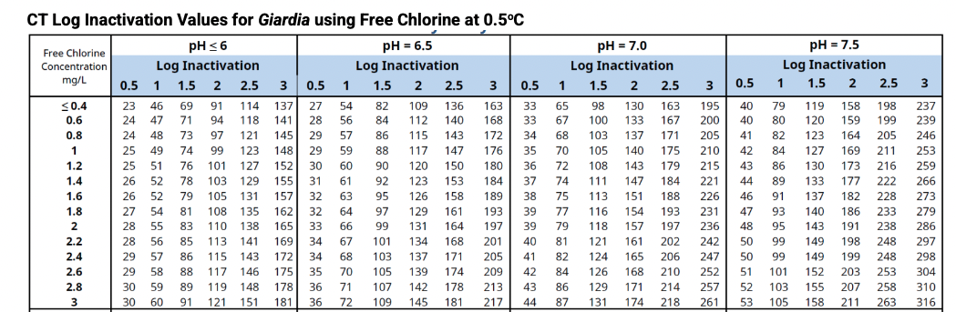
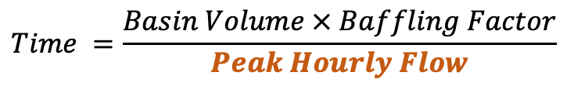
Treatment Requirements
Primary Disinfectant | Requirements
Free Chlorine | The water system shall meet the required CT value, at a minimum, as outlined in Section 9.7 and Appendix 9-D. In the event the minimum required CT is not achieved, contingencies shall be in place to prevent the distribution of inadequately disinfected water. The AFNWA shall work collaboratively with the oversight entity to determine if site-specific requirements may apply.
As long as the contact time the operator measures at the plant is greater than that required by the Regulations, the water passes the disinfection portion of the treatment process.
$$Time =\frac{Basin Volume × Baffling Factor}{Peak Hourly Flow}$$
$$Available Time =Time × Chlorine conc.$$

Slide 10

Treatment Requirements + Monitoring + Reporting
Primary Disinfectant | Requirements
Free Chlorine | The water system shall meet the required CT value, at a minimum, as outlined in Section 9.7 and Appendix 9-D. In the event the minimum required CT is not achieved, contingencies shall be in place to prevent the distribution of inadequately disinfected water. The AFNWA shall work collaboratively with the oversight entity to determine if site-specific requirements may apply.
Things to be recorded: | Data
 | Calibration schedule
 | Maintenance schedule (PM & RM)
Treatment requirements
set monitoring requirements
Monitoring requirements set data
recording and reporting
Things to be measured: | Peak hourly flow
 | Temperature
 | pH
 | Chlorine residual
Things to be calibrated: | Flow meter
 | Thermometer
 | pH probe
 | HACH instrument

Slide 11
Other Treatment Requirements – set a path forward
The facility shall have a minimum of two primary disinfection units to ensure that inadequately disinfected water is not distributed. Each disinfection unit shall be capable of meeting the maximum day demand flow.
Continuous on-line monitoring of the primary disinfection process is required at each treatment facility with measurements taken at a minimum of once every five minutes to ensure that inadequately disinfected water does not enter the distribution system.
Water systems shall be equipped with alarm capabilities to notify operations staff if the disinfection process fails to operate properly to prevent inadequately disinfected water from being distributed.
Standard Operating Procedures (SOPs) for the disinfection process shall be developed, implemented and communicated to all operations staff.
If engineered filtration is necessary, a minimum of two filters (redundancy) is required.
Continuous monitoring is required for individual filter effluent
Treatment requirements are source water and system specific and will be determined for each facility.

Slide 12
Interim Regulations for Drinking Water
Operations
and
day-to-day activities

Slide 13
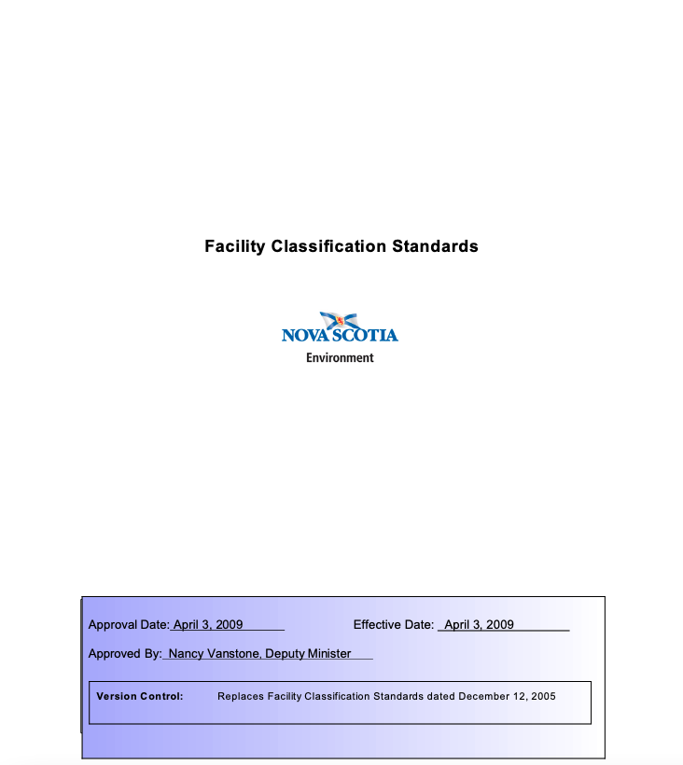
Facility Classifications
Facility
Points Received | Class of Facility
30 points or less | Class I
31-55 points | Class II
56-75 points | Class III
76 points or more | Class IV
Distribution System
Population Served | Class of Facility
500* - 1500 | Class I
1501 - 15 000 | Class II
15 001 or more | Class III
*Any AFNWA centralized drinking water system serving less than 500 people will be classified as a Class I distribution system.

Slide 14
Water Treatment Facility Classifications Parameters
Facility | Water Treatment Process | Average Water Consumption (Theoretical) | Average Flow (Million Liters/d)
Abegweit (Scotchfort, Morell, Rock Point) | Sodium hypochlorite | 7 m³/d | 0.007
Elsipogtog | UV, sodium hypochlorite | 1092 m³/d | 1.092
Esgenoopetitj | UV, sodium hypochlorite | 560 m³/d | 0.56
Eskasoni | UV, sodium hypochlorite | 1600 m³/d | 1.6
Kingsclear | UV, sodium hypochlorite | 300 m³/d | 0.3
Lennox Island | Sodium hypochlorite | 164 m³/d | 0.164
Paqtnkek | Potassium permanganate, greensand filter, sodium hypochlorite | 180 m³/d | 0.18
Pictou Landing | Sodium hypochlorite | 208 m³/d | 0.208
Potlotek | Coagulation, flocculation, dissolved air filtration, anthracite filters, greensand filters, GAC, UV, sodium hypochlorite | 252 m³/d | 0.252
Sipekne'katik-Indian Brook | Greensand filter, sodium hypochlorite | 558 m³/d | 0.558
Sipekne’katik – New Ross | Greensand filters, individual Point-of-entry UV and Reverse Osmosis | 10 m³/d | 0.01
Tobique | Sodium hypochlorite | 660 m³/d | 0.66
Wagmatcook | Water softener, UV sodium hypochlorite | 328 m³/d | 0.328

Slide 15
Item | Points
Size
Design flow average day, or peak month’s average day, whichever is larger (1 point per 1.892 million litres. Round up.) Design flow: Consider this to be the design capacity of the plant. Examples 40 MLD = 19 points 18.9 MLD = 10 points (20 points maximum allowed) | 1 - 20
Water Supply Sources (Rating based on public health significance)
Seawater/saltwater | 0
Groundwater (non-GUDI) | 0
Groundwater under the direct influence of surface water (GUDI) | 8
Surface water | 10
Average Raw Water Quality Variation – Applies to all sources (surface and groundwater). Key is the effect on treatment process changes that would be necessary to achieve optimized performance
Little to no variation – no treatment provided except disinfection | 0
Minor variation – e.g. “High quality” surface source appropriate for slow sand filtration | 1
Moderate variation in chemical feed, dosage changes made monthly | 2
Variations significant enough to require pronounced and/or very frequent changes | 5
Severe variations - source subject to non-point discharges, agricultural / urban storm runoff, flooding | 7
Raw water quality subject to agricultural or municipal waste point source discharges | 8
Raw water quality subject to industrial waste pollution | 10
Raw water quality is subject to:
Taste and/or odour for which treatment process adjustments are routinely made | 2
Colour > 15 TCU (not due to precipitated metals )¹⁴ | 3
Iron and/or manganese: Fe (2 points) or Mn (3 points) concentrations above aesthetic objective 3 points maximum allowed¹⁴ | 2 - 3
Algal growths for which treatment process adjustments are routinely made¹⁴ | 3
Pre-filtration (staged filtration, pressure sand w/o coagulation, etc.): add one point per stage to a maximum of 3 points | 1 - 3
Slow sand | 5

Slide 16
Chemical Treatment/Addition Process
Fluoridation | 4
Disinfection/Oxidation (Note: Points are additive to a maximum of 15 points allowed for this category.) Check all that apply: • Chlorination: Hypochlorites (5 points) If generated on site (add 1 point) Chlorine gas (8 points) Chloramination (10 points) Chlorine dioxide (10 points) • Ozonation (10 points) • UV Irradiation (2 points) • Iodine, Peroxide, or similar (5 points) • Potassium permanganate (4 points) (if used with greensand filtration do not give 4 points) | 0 - 15
pH adjustment for process control (e.g. pH adjustment aids coagulation | 4
Stability or Corrosion Control (If the same chemical is used for both Corrosion Control and pH adjustment, count points only once) | 4
Coagulation / Flocculation and Filter Aid
Primary coagulant addition | 6
Coagulant aid / Flocculant chemical addition (in addition to primary coagulant use) | 2
Flocculation | 2
Filter aid addition (non-ionic/anionic polymers) | 2
Clarification/Sedimentation
Sedimentation (plain, tube, plate) | 4
Contact adsorption | 6
Other Clarification processes (air flotation - DAF, ballasted clarification, etc) | 6
Upflow clarification (“sludge blanket clarifier”) | 8
Filtration
Granular media filtration (Surface water / GUDI) < 122 lpm / sq m | 10
Granular media filtration (Surface water / GUDI) > 122 lpm / sq m | 20
Groundwater filtration | 6
Membrane filtration | 10
Diatomaceous earth (pre-coat filtration) | 10
Cartridge / bag filters | 5

Slide 17
Other Treatment Processes
Aeration | 3
Air stripping (including diffused air, packed tower aeration | 5
Ion-exchange/softening | 5
Greensand filtration | 10
Lime-soda ash softening (includes: chemical addition, mixing/flocculation/clarification/filtration - do not add points for these processes separately) | 20
Granular activated carbon filter (do not assign points when included as a bed layer in another filter) | 5
Powdered activated carbon | 2
Reservoir management employing chemical addition | 2
Blending sources with significantly different water quality • To achieve health related compliance (4 points) • For aesthetic reasons (2 points) | 2 - 4
Electrodialysis | 15
Other: The AFNWA, in consultation with the oversight entity, may assign 2 to 15 additional points for processes not listed elsewhere in this document. (Specify: ______________________________________________) | 2 - 15
Residual Disposal
Discharge to surface, sewer, or equivalent (0 points) • On-site disposal, land application (1 point) • Discharge lagoon / drying bed, with no recovery / recycling - e.g downstream outfall (1 point) • Backwash recovery/recycling: discharge to basin or lagoon and then to source (2 points) • Backwash recovery/recycling: discharge to basin or lagoon and then to plant intake (3 points) | 0 - 3

Slide 18
Facility Characteristics
Instrumentation - Use of SCADA or similar instrumentation systems to provide data, with: • Monitoring / alarm only, no process operation - plant has no automated shutdown capability (0 points) • Limited process operation - e.g. remote shutdown capability (1 point) • Moderate process operation - alarms and shutdowns, plus partial remote operation of plant (2 points) • Extensive or total process operation - alarms and shutdowns, full remote operation of plant possible (4 points) | 0 - 4
Total number of assigned points | Use Table 10.1 to determine classification
Points Received | Class of Facility
30 points or less | Class I
31-55 points | Class II
56-75 points | Class III
76 points or more | Class IV

Slide 19
Water Treatment Facility Classifications
Water Treatment Facility Classifications
Facility Name | Facility Classification
Abegweit (Scotchfort, Morell, and Rock Point) | Class I
Elsipogtog | Class I
Esgenoopetitj | Class I
Eskasoni | Class I
Kingsclear | Class I
Lennox Island | Class I
Paqtnkek | Class I
Pictou Landing | Class I
Potlotek | Class IV
Sipekne'katik-Indian Brook | Class II
Sipekne’katik – New Ross | Class I
Tobique | Class II
Wagmatcook | Class I
Operations
and
day-to-day activities

Slide 20

Monitoring Requirements
How often it needs to be measured
Where it needs to be measured
What needs to be measured
Non-GUDI System
Turbidity
Turbidity | Raw water Samples to be collected at the wellhead for each of the production wells, or at point where raw water mixes. | Daily grab samples or continuous monitoring at 5-minute intervals. Continuous monitoring not currently available so grab samples pending system upgrades.
 | Treated Water The treated water’s turbidity should be monitored to support strong secondary disinfection in the distribution system. | Daily grab samples or continuous monitoring at 5-minute intervals.
 | Distribution system sample points Sample turbidity during weekly microbiological sample collection. | System Turbidity levels shall be checked when the weekly micro-biological samples are collected.

Slide 21
Monitoring Requirements
CT

Slide 22
Monitoring Requirements
Secondary Disinfection (Parameters to be monitored depend on the disinfection method used)
Free Chlorine Residual | Clearwell Sample chlorine residual of treated water leaving the Clearwell | Daily grab samples or continuous monitoring at 5-minute intervals. Continuous monitoring not currently available so grab samples pending system upgrades.
 | Water Tower/Reservoir Sample free chlorine residual of the water exiting the reservoir before entering the distribution system | Daily grab samples or continuous monitoring at 5-minute intervals. Continuous monitoring is not currently available so grab samples pending system upgrades.
 | Distribution system sample points Sample residuals throughout the distribution system. Number and locations of samples to be determined. | Weekly with microbiological sample collection
New Operator
Responsibilities

Slide 23
Monitoring Requirements
Microbial Quality
Total Coliforms and E. coli (present/absent) | Water entering the distribution system Sample for Total Coliforms and E.Coli as water enters the distribution system from the Clearwell. | Weekly grab samples
 | Distribution system sample points Sample for Total Coliforms and E. Coli throughout the distribution system. Number and location of sample locations to be determined. | Weekly grab samples
Giardia and Cryptosporidium | Raw water Sample at the wellheads of the three production wells | Annually
 | Treated Water Sample at point where treated water enters the Clearwell and exits the Clearwell. | Annually
New Operator
Responsibilities

Slide 24
Monitoring Requirements
Lead Monitoring Program
Lead & Copper | Lead/Copper Monitoring-Point of entry and representative locations within the distribution system based on population served: Sample at the point where treated water leaves the Clearwell before entering the distribution system. Distribution sample number and locations to be determined. | Annually during warmer months
Likely a joint project with AFNWA Engineering/Ops staff and operators

Slide 25
Monitoring Requirements
Disinfection By-products
Total Trihalomethanes (THMs) | Treated Water: Select distribution system sampling point(s) – representative of the highest levels (e.g. areas with the longest retention times). | Quarterly grab samples
Haloacetic Acids (HAAs) | Treated Water: Select distribution system sampling point(s) – where historical data show the highest concentrations or in the middle and extremities of the distribution system. | Quarterly grab samples
Chlorate – if storing sodium hypochlorite more than 3 months ☐ N/A | Water entering the distribution system | Quarterly
Bromate – if storing sodium hypochlorite more than 3 months ☐ N/A | Water entering the distribution system Insert/list sample location. | Quarterly
Likely a joint project with AFNWA Engineering/Ops staff and operators

Slide 26
Regulations set when AFNWA staff have
to report things.
Immediate reporting:
Any an incident that may adversely affect the quality of the water within the Community Drinking Water Supply – including not achieving CT
Any analytical results that exceed the MAC of health­ related parameters listed in the "Guidelines for Canadian Drinking Water Quality"
When bacteria are detected in the Community Drinking Water Supply
If the chlorine residual in the water distribution system is less than 0.20 mg/L free chlorine
Where turbidity values are greater than 5.0 NTU are observed in the water distribution system
Prior to the use of a backup water system
Operations
and
day-to-day activities

Slide 27

Clear steps to guide activities, record keeping, and reporting activities
These will be developed to support the Regulations and make roles, responsibilities, and communication processes clear
Record keeping, maintenance and monitoring documentation will be needed to communicate compliance to regulatory standards
Standard
Operating
Procedure
Operations
and
day-to-day activities

Slide 28
Next steps with the CWRS
Continued community sampling to develop Annual Sampling Plan … Distribution sample number and locations to be determined.
Finalizing the Interim Regulations
Assisting with the development of Nujo’tme’k Samqwan Safety Plans
Assisting with SOP development for water quality monitoring and QA/QC development

Slide 29
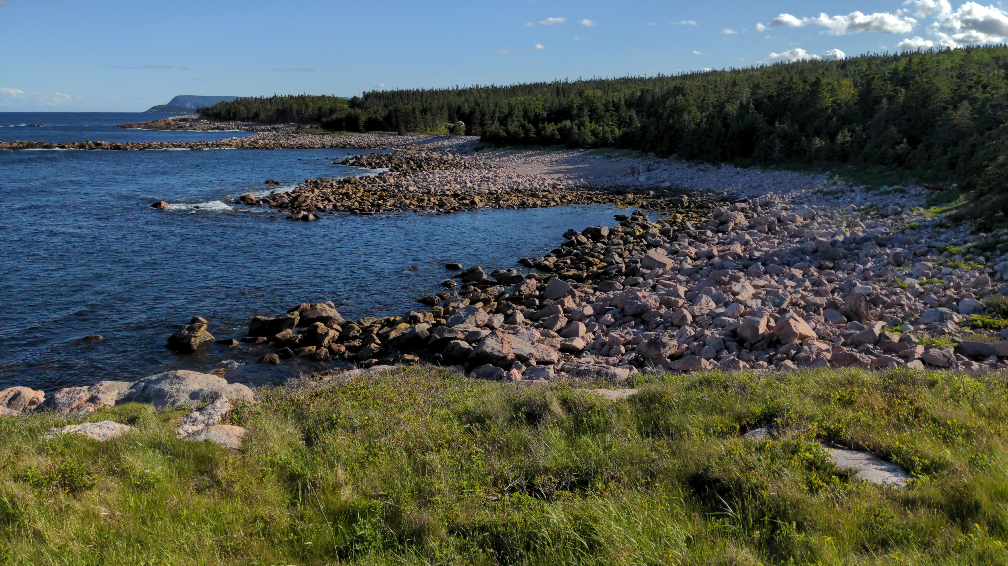
We'lalin

